Slide 1
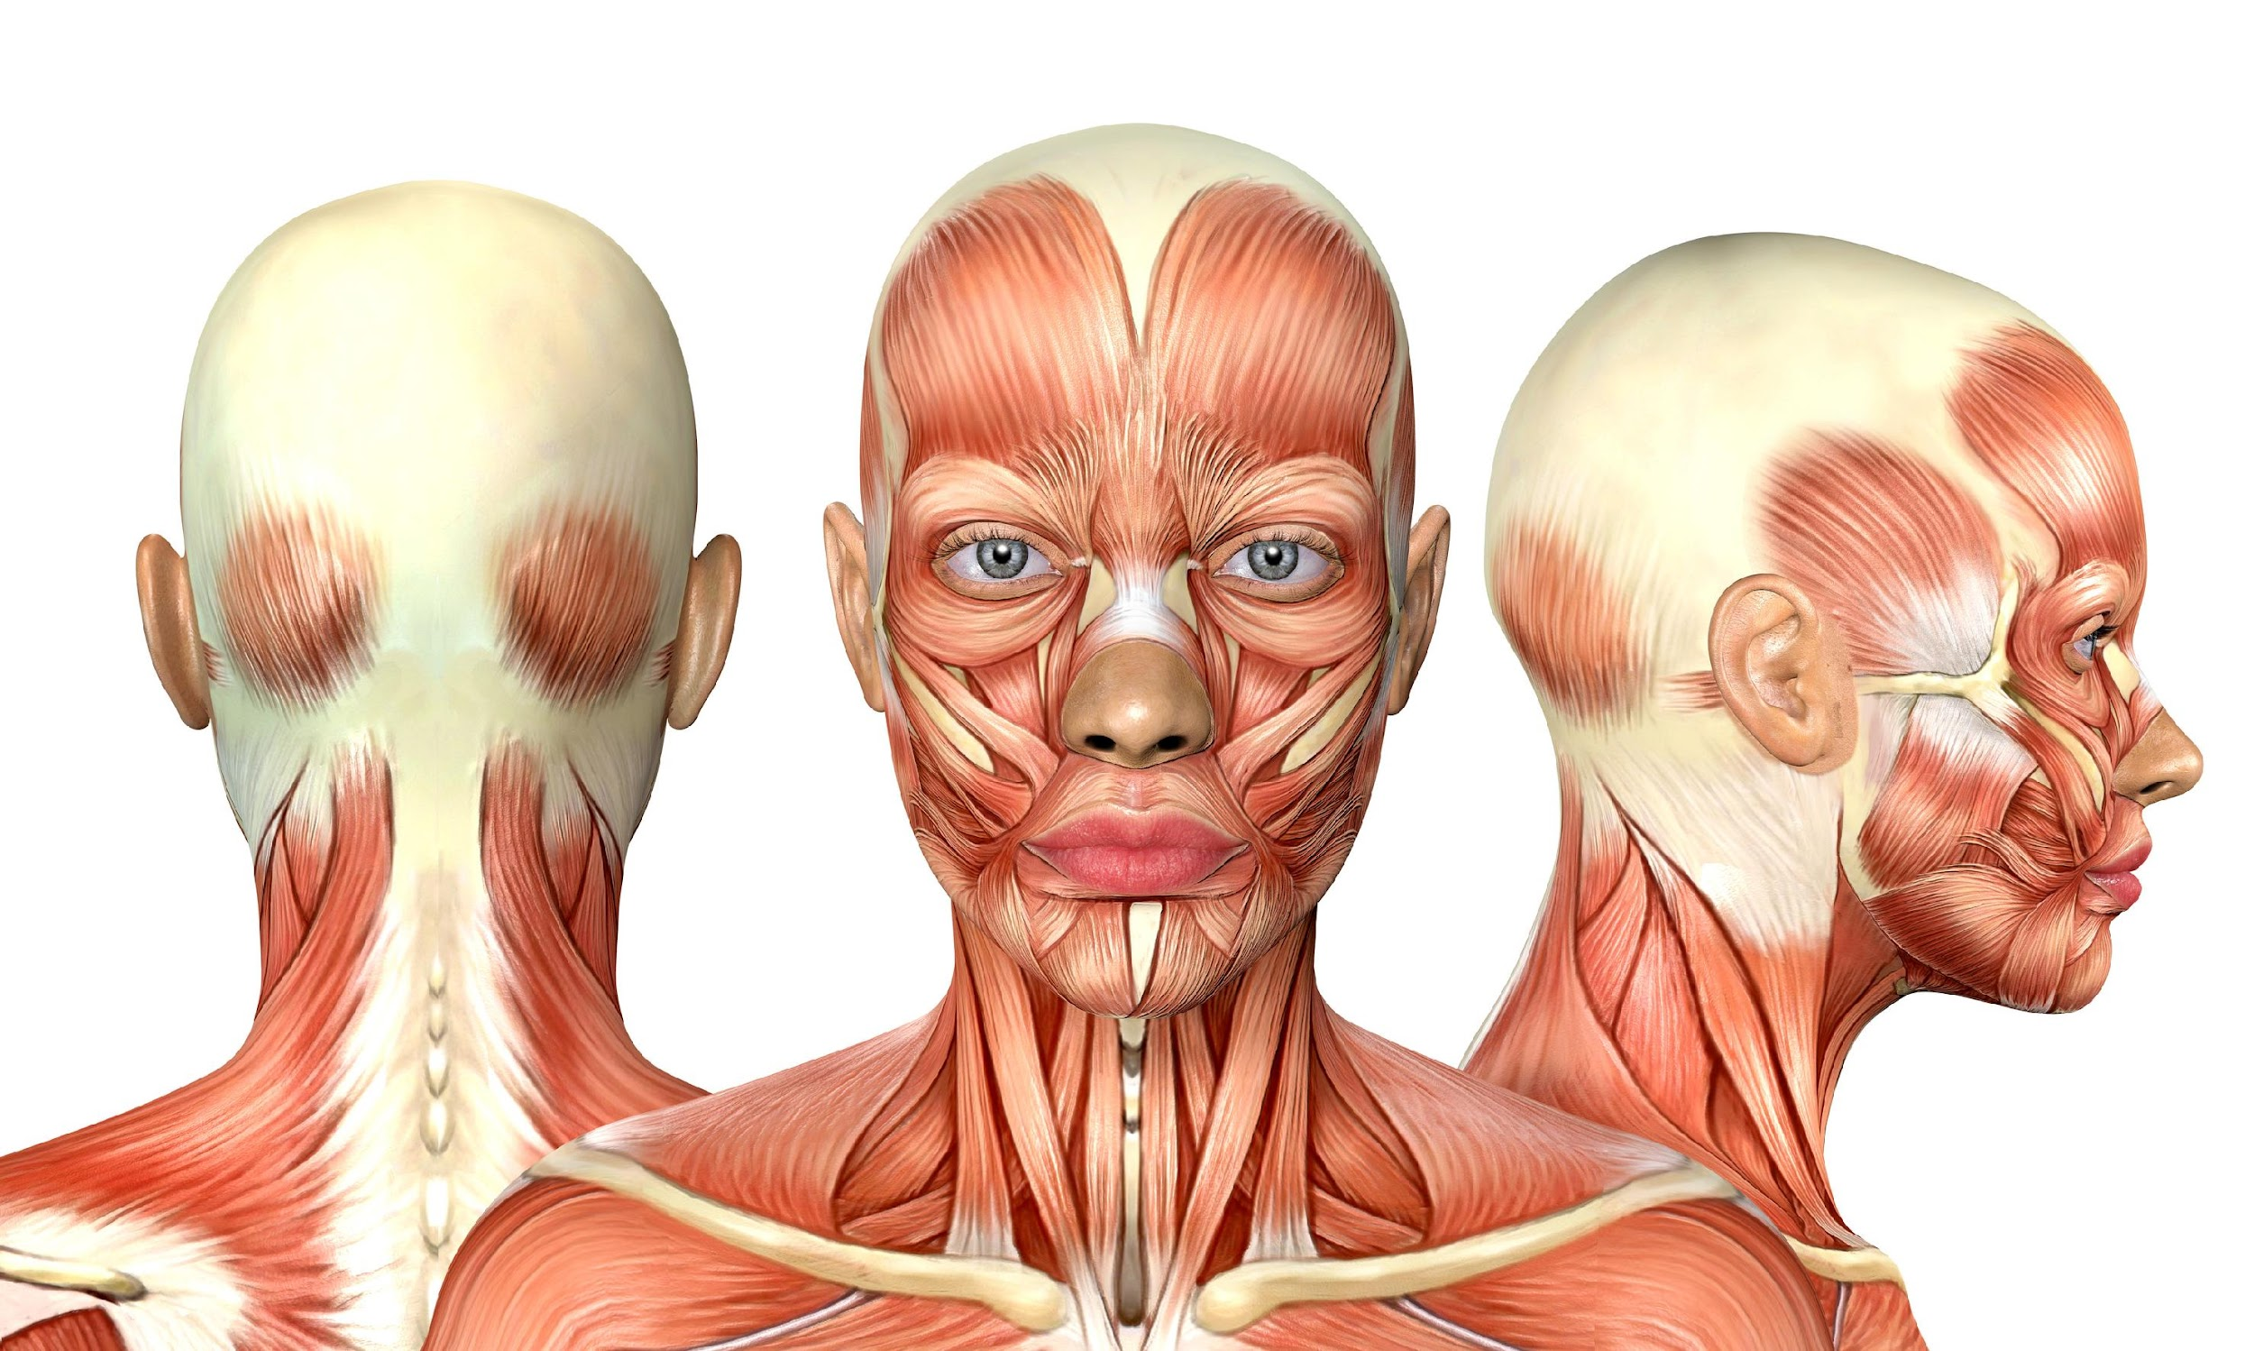
The Curve of Spee
Hyoid Connection
from TMJ Disease

Slide 2
Anterior teeth higher than posterior teeth - taught in dental school. Consequences of this - why - Curve of spee is pathology
Anterior teeth NOT super erupted.
Intrusion of posterior teeth due to clenching-
Shortened muscle attachments - dysfunctional -
Masseter "bails out" - no recruitment on EMGs
Addition of cotton rolls on posterior teeth
Curve of Spee:
Why?

Slide 3
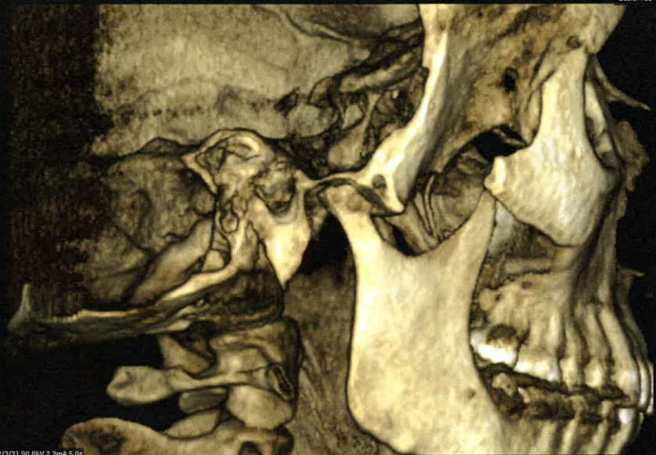
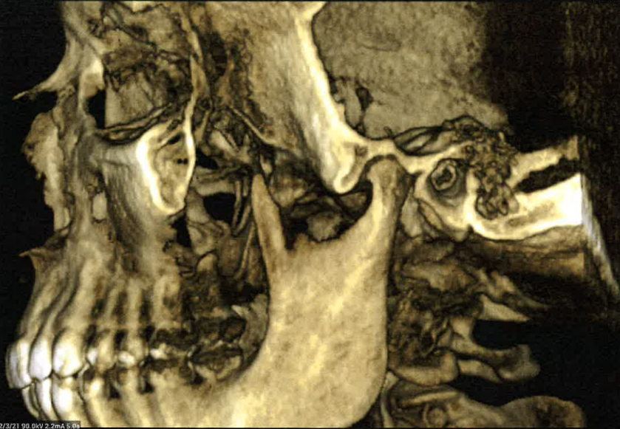

Slide 4
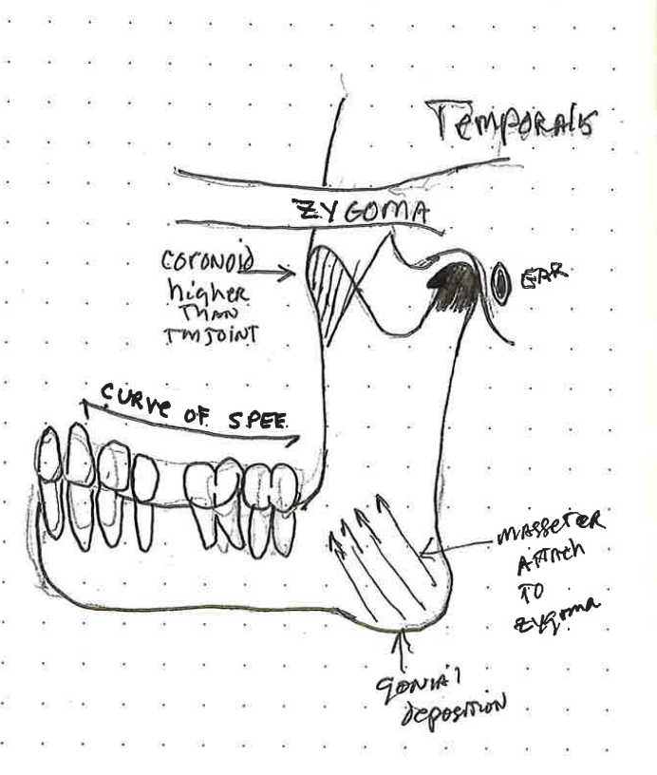
Anatomy of Curve of Spee
Jaw Relation

Slide 5
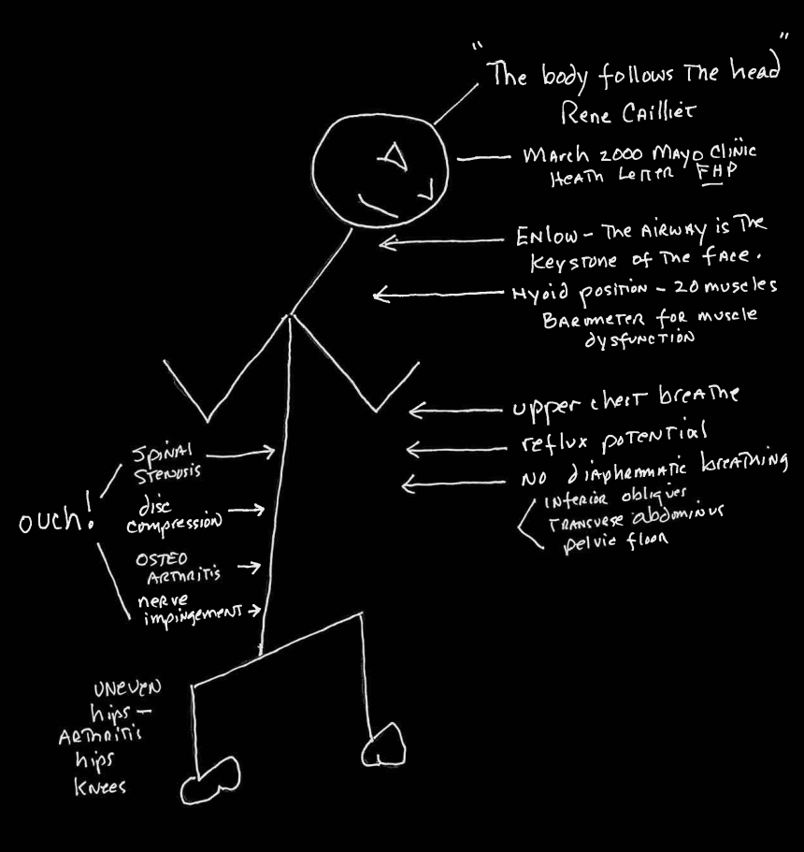
The affect of forward head posture:
With Curve of Spee

Slide 6
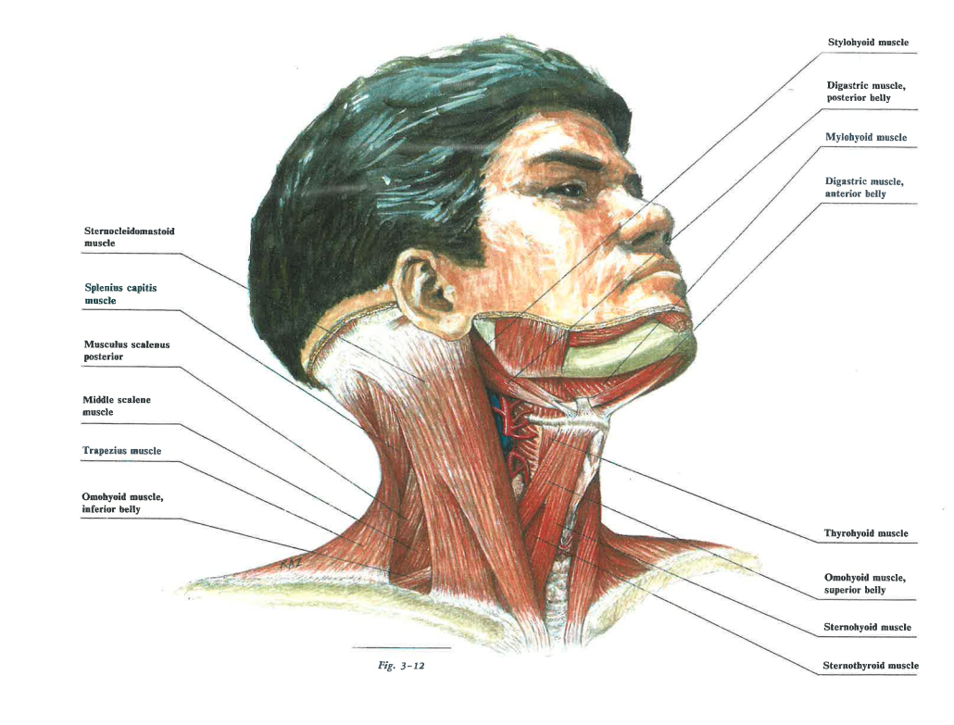
Muscle Connection
Primary closure muscles TMJ/temporalis NOT in harmony. Cannot recruit for bite force/swallow/breathing 5000x/day [form follows (dys)function]
Vertical Dimension compromise creates dysfunctional muscle and changes bone.
Mandible-gonial deposition bilateral (masseter attachment)
Coronoid hyperplasia attenuation- temporalis imbalance coronoid higher than the
TMJoint capsule.
Posterior superior condylar position in fossae

Slide 7
The Hyoid
"Change in hyoid bone position in patients treated for and resolved of myofascial pain."
Cranio 2020 Vol. 38, No, 2, 74-90
Pg. 83-84 "Perhaps as muscles in the throat RELAX, head posture corrects itself because it no longer must compensate for reduced airway."
Pg. 84 "This change in hyoid position suggests a RELAXATION of supra hyoid musculature, tongue position, and coincident change in oropharyngeal and airway dimensions. Position of the tongue has been suggested as more important in airway size than the size of the soft palate."
Pg. 84-85 "One of the authors interests for future investigation is the effect this change in RESTING hyoid position may have on airway dimension. The hyoid bone and its posture have been related to the stabilization and maintenance of the airway. The airway is dependent upon soft tissue volumes and the bony confinements that determine its dimension. The hyoid serves as a prop to maintain a patent airway, providing an attachment for the muscles of the anterior neck. Hyoid bone position has also been related to OSA"
*Pg 85 "Upward positioning of the hyoid bone has been related to a significant reduction in posterior lingual airspace. The possibility of a RELAXED suprahyoid complex in the resolved myofascial pain patient and affiliated opening of the airway space is evident."
*Pg 86 "These finding suggest that resolution of myofascial pain may correlate with decreased forward head posture AND RELAXATION of suprahyoid musculature.
GOAL: When treating TMJ/ Sleep Apnea/Breathing/Swallow establish a neuromuscular functional environment for the supra/intra hyoid musculature
Ronald C Avvenshine DDS, PHD
Nathan J. Pettit DMD MSD
RELAX
RELAXATION
RESTING
RELAXED
RELAXATION
GOAL

Slide 8
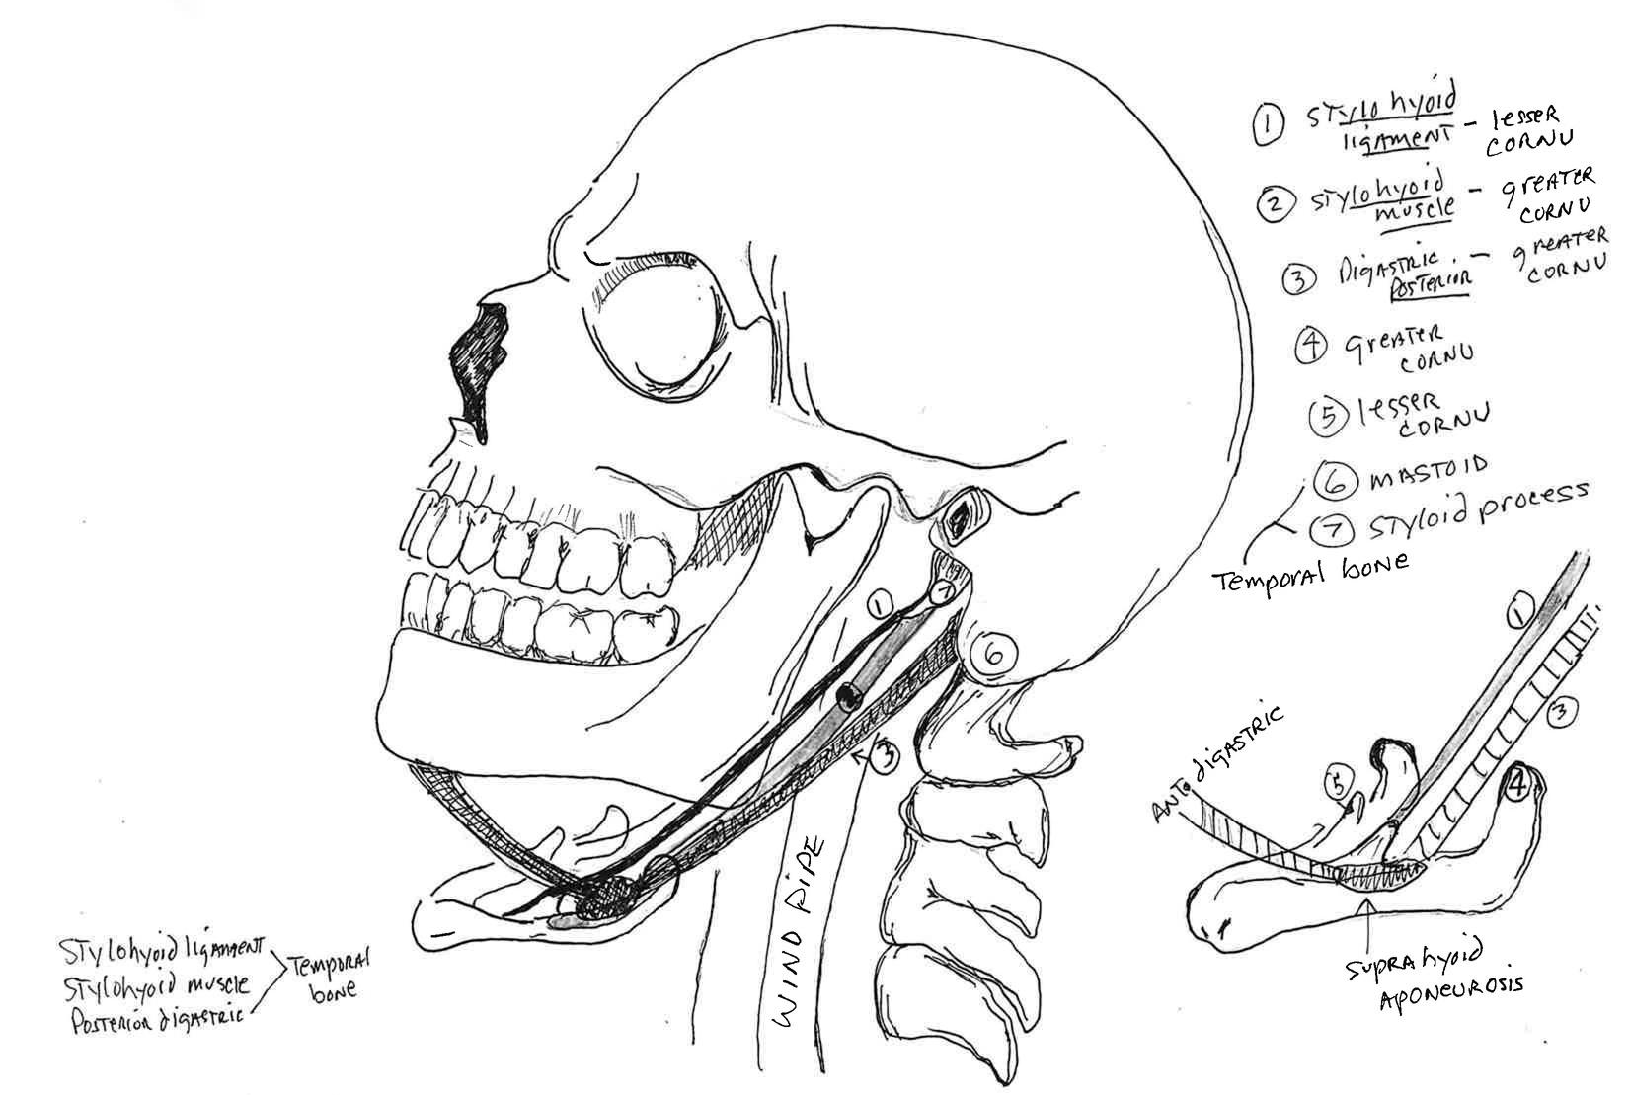
The Hyoid Bone
20 muscles insert into the hyoid bone.
The hyoid bone is responsible for airway and posture due to the outer flanges and central positioning of the bone in the throat.

Slide 9
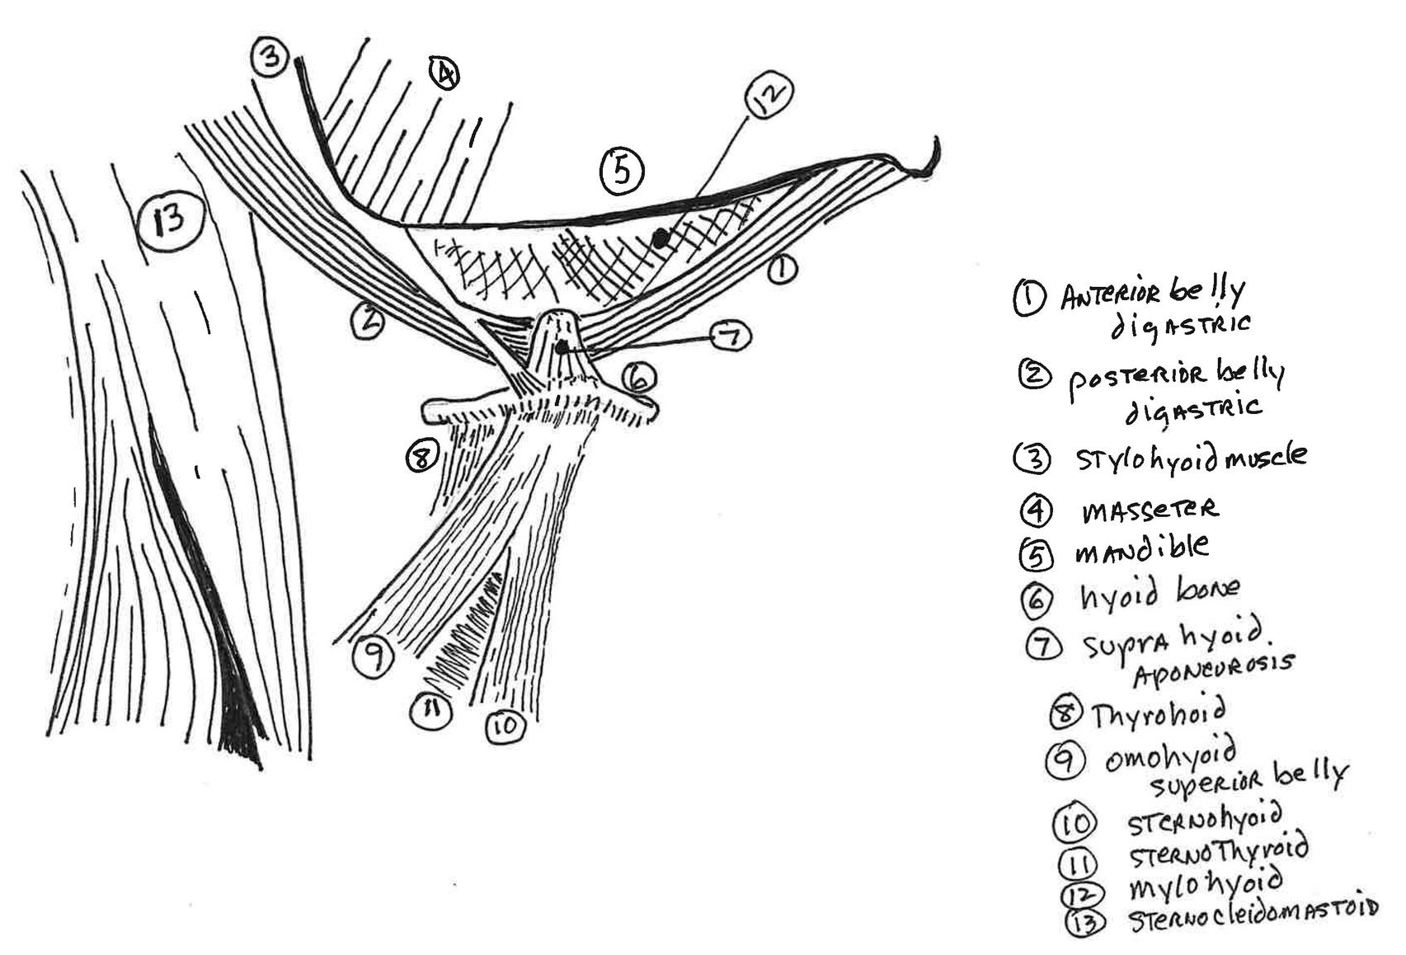
The Hyoid Bone
There are only 2 muscles from the skull that insert into the hyoid bone.
Posterior digastric
Stylohyoid muscle
They form an aponeurosis on the greater cornu of the hyoid (spot weld).
The head become a lever associated with bad or good posture and (dys)functional bite.

Slide 10
Muscles Affecting Hyoid Position
Hyoid Bones
“It is at the level of the fourth cervical vertebrae and its greater cornu extends back on a level with the angle of the mandible”
Pg 57 Grays Anatomy
Stylohyoid muscle perforated by the posterior digastric on the greater cornu of the hyoid.
“The two bellies end in an INTERACTIVE TENSION which PERFORATES the stylohyoideous muscle and is held in connection with the side of the body
Notes:
Slide 10 word change hyoid position interactive tension which perforates

Slide 11
Optimization of bite and posture optimizes airway and diaphragmatic breathing

Slide 12
The Hyoid - Liz

Slide 13
Case Studies

Slide 14
Curve of Spee Cervical
Air Way Relationship

Slide 15
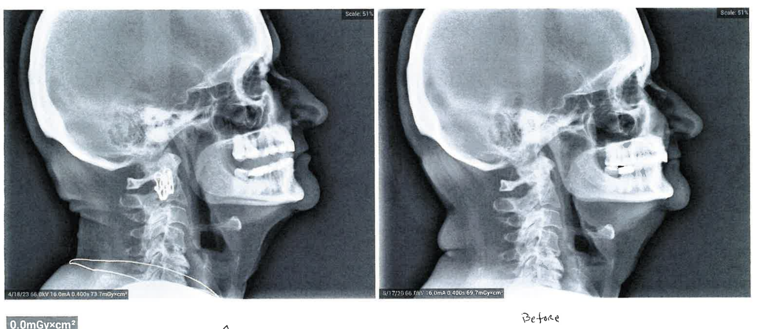
Curve of Spee
After:
Neuromuscular Appliance
Before:
On Natural Teeth

Slide 16
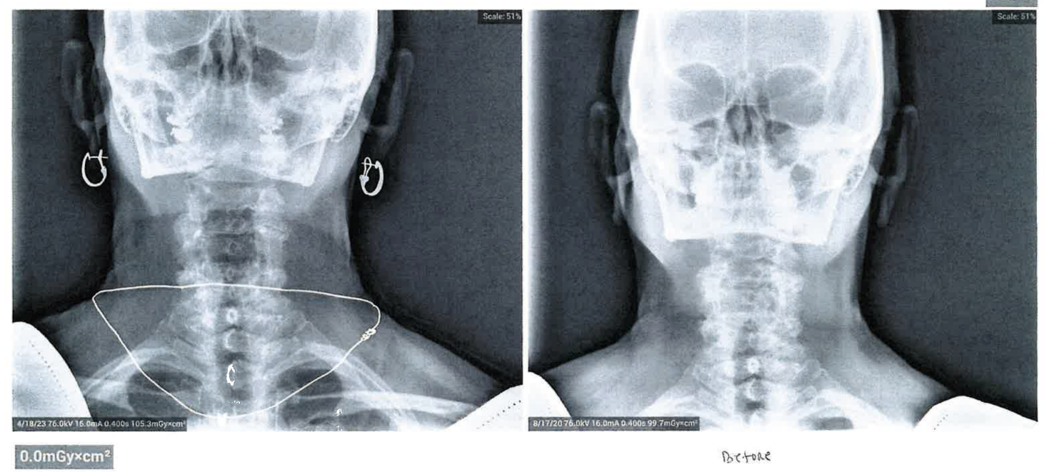
NM Therapy
After
Before

Slide 17
Trigeminal Nerve Case Study

Slide 18
5 Year Old Patient Case Study

Slide 19
Pre & Post Case Study
Cervical Component
Orthotic 2
Orthotic 1
Before
OPTIMIZATION OF BITE AND POSTURE OPTIMIZES AIRWAY

Slide 20
*R. Cailliet
GOAL: When treating TMJ/Sleep Apnea/Breathing/Swallow establish a neuromuscular functional environment for the supra/intra hyoid musculature allowing the hyoid to establish a lordotic curve to the cervical spine by its optimization of its position in the neck/throat.
Crucial- Environment of the throat- directly affected by masticatory environment responsible for:
Airway integrity
Postural integrity
Hyoid position
Cannot achieve this UNLESS you can measure muscle (dys)function. So, you can correct it (NMO/Posture)
ALSO: Proper consistent postural therapy augments the constant functional message of the neuromuscular orthotic 5000x/day to reduce forward head position and discal/vertebral/rotation compression while creating an avenue for diaphragmatic breathing (NOT upper chest as with forward head posture)
*R. Cailliet, former director at University of Southern California department of physical medicine and rehabilitation, said that Forward head posture may result in a loss of 30% of vital lung capacity. These breath related effects are primarily due to loss of cervical lordosis which blocks the action of the hyoid muscles- especially the inferior hyoid responsible for helping lift the 1st rib during inhalation. He also states- most attempts to correct posture are diverted toward the spine, shoulders and pelvis, all are important, but the HEAD position takes precedence over all others. THE BODY FOLLOWS THE HEAD therefore, the entire body is ALIGNED by first restoring proper functional alignment to the head.
Treating TMJ, orthodontic, orthopedic problems and sleep apnea all manifest from dysfunctional musculature that is based on the mandibular/condylar position in the TMJoint when occlusion takes place. (Genetic/Habitual)
Creating a “healthy” hyoid position is dependent on recognizing, measuring, treating and eliminating the curve of spee found in our patients.

Slide 21
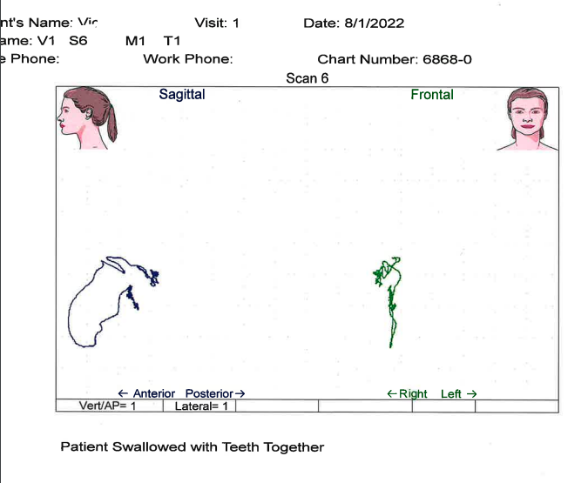
The Water Test: Swallow Scan
3000 times a day with Accessory muscles

Slide 22
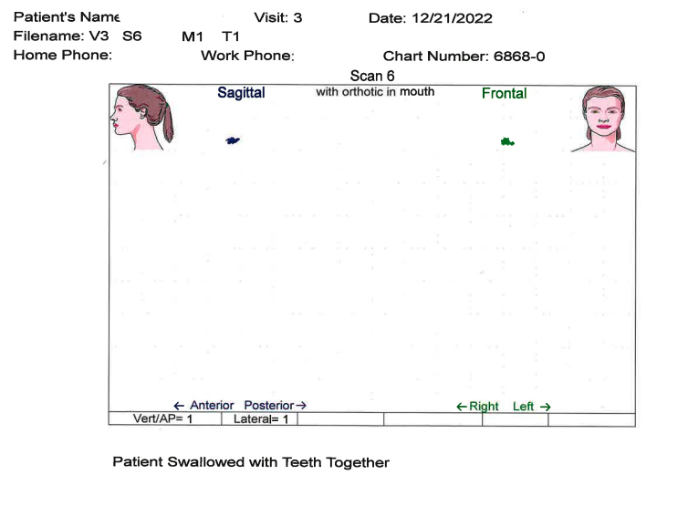
Normal Swallow on Teeth / Orthotic

Slide 23
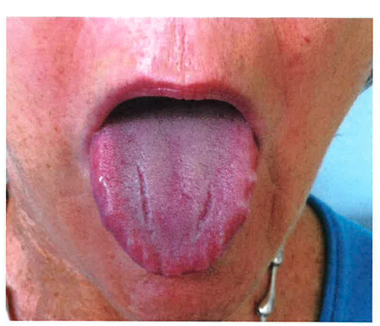
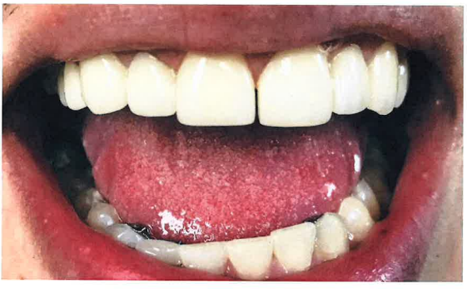
Scalloped Tongue
Scalloped tongue - swallow dysphagia.
No recruitment (muscle on swallow) tongue finds alternative and presses against teeth for anchorage.
Forward head posture created by age 5.
Upper chest breathing/mouth breathing
This environment portrays a dysfunctional muscle/jaw environment that will influence the hyoid position in the throat affecting posture, breathing (airway) and swallow.

Slide 24
Chronic Pain - Why?

Slide 25
Chronic Pain - Why?

Slide 26
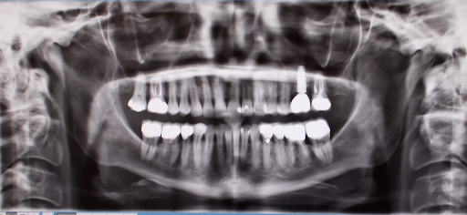
Panorex Use Can Reveal:
High coronoids (attenuated) – temporalis imbalance
Gonial deposition – masseter clench
Not Diagnostic for condyles/position in fossae

Slide 27
TMJ Disease will create:
Forward Head Posture (even in children)
Swallow dysfunction-breathing-GERD
Facial pain
Temporalis pain – temporal headaches
Pain behind eyes, condylar pain
No Diaphramatic breathing
Intrudes posterior teeth
3-Dimensional Intra-oral imbalance
Condyles move posteriorly, superiorly

Slide 28
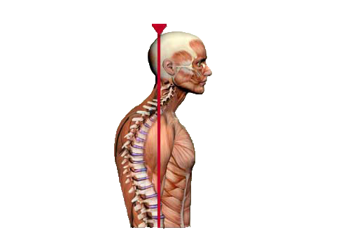
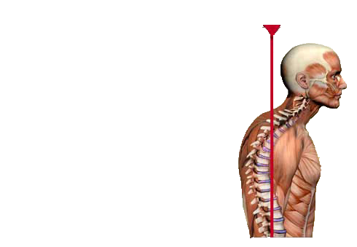
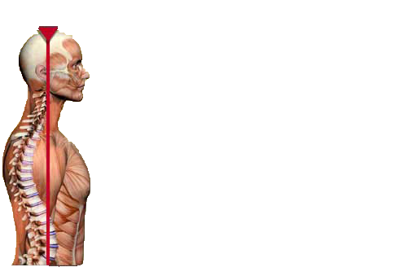
Did You Know?
12 lb. head
32 lb. head
42 lb. head
Forward Head Position can create over 40 lbs. of pressure on the musculoskeletal system
Longer head remains forward, more the spine is compressed AND muscles are shortened
“Forward Head Posture (FHP) leads to long term muscle strain, disk herniation, arthritis, and pinched nerve.” – Mayo Clinical Health Letter, March 2000
For every inch of Forward Head Posture, it can increase the weight of the head on the spine by an additional 10 lbs.

Slide 29
TMJ Disease and Sleep Apnea:
Retruded jaw position
Forward head posture
No energy
RETRUDED JAW
Sleep
Apnea
Bilateral gonial deposition results from masseter clench
Neck/shoulder/back problems
No room for tongue: scalloped lateral border
Narrow Maxilla
Narrow Mandible
Lower anteriors higher than posterior teeth
Airway impediment

Slide 30
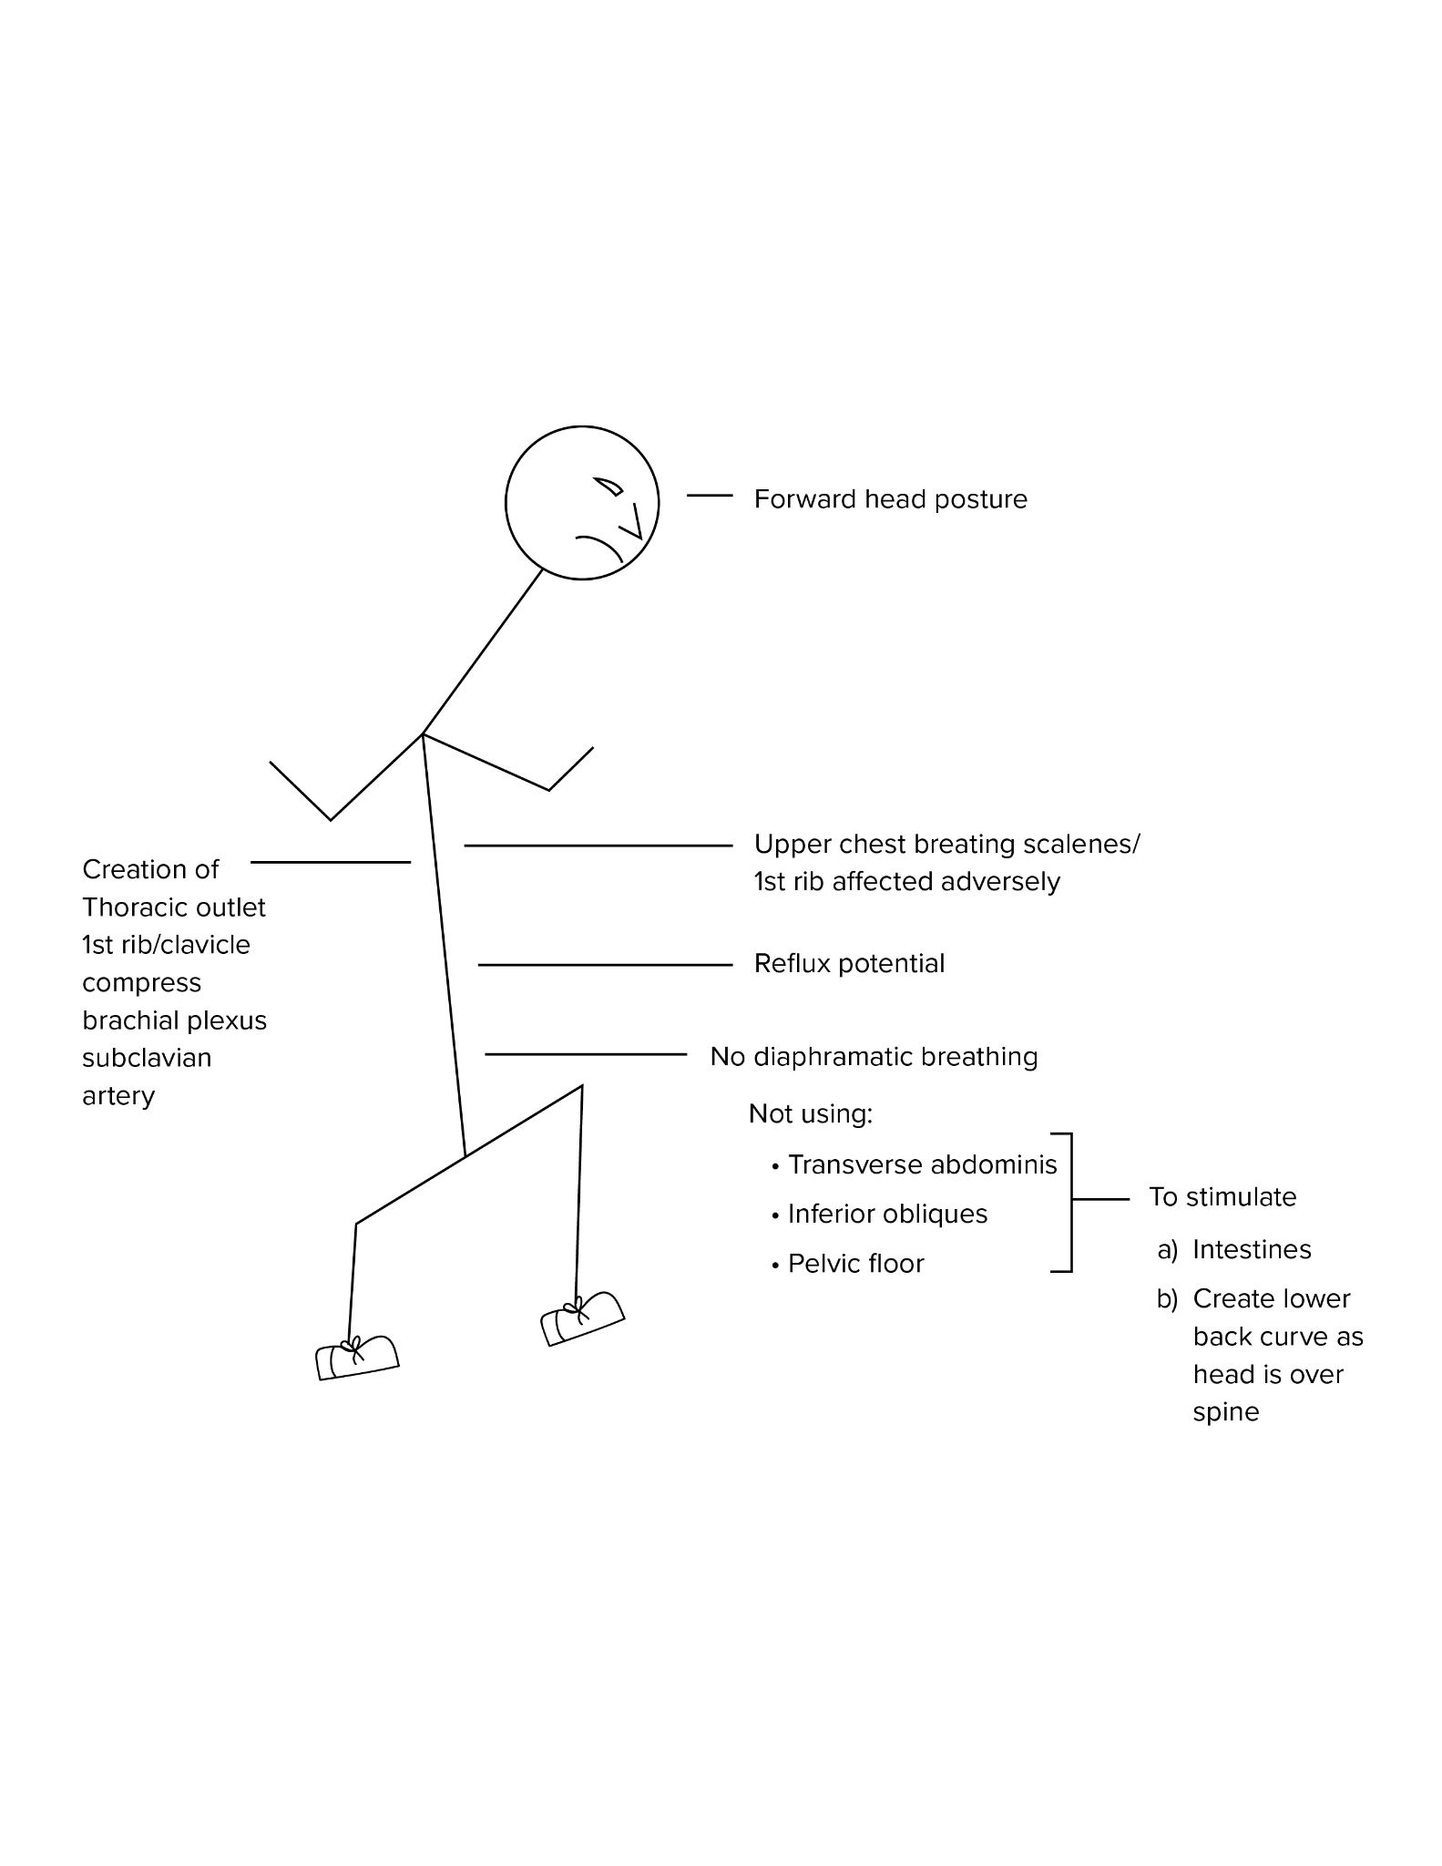
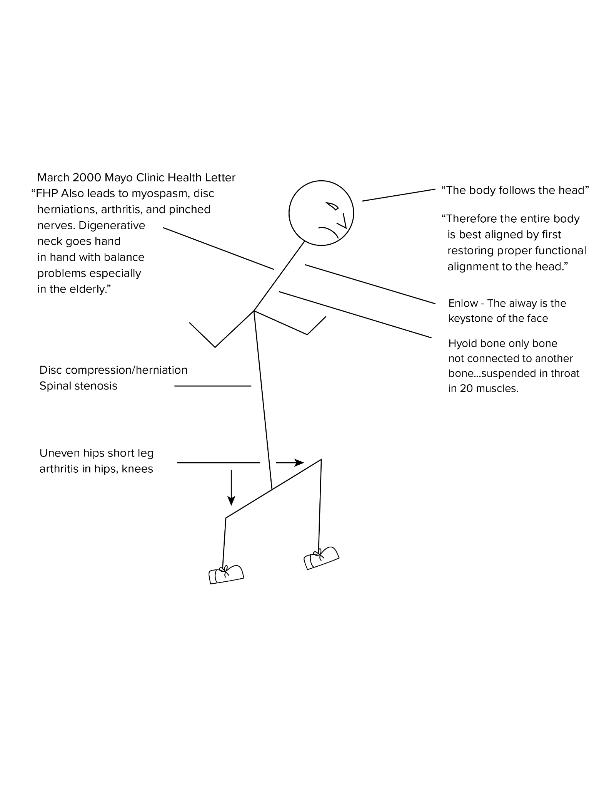
FHP, Sleep Apnea, & Posture Concerns
Cailliet

Slide 31
Potential Class lll TMJ Sleep Apnea Patient
Age 9, Postural Sleep Concerns, Resolved of Symptomology
BEFORE
AFTER 4 MONTHS

Slide 32
"Mom, my throat is open, I can breathe."
This quote is from a 9 year old girl who had problems with swallowing, breathing and operations for fluid in her ears. Close inspection revealed a deep bite or over closure. This deep bite brings the lower jaw backwards toward the ear and brings the tongue and neck muscles backwards toward the throat impeding airway.
Through neuromuscular computer and tomography x-ray, a proper bite was established that eliminated the deep bite and brought the jaw forward; thus relieving the TM Joints, bringing the tongue and muscles attached to the jaw forward. This will create an open airway day and night.

Slide 33
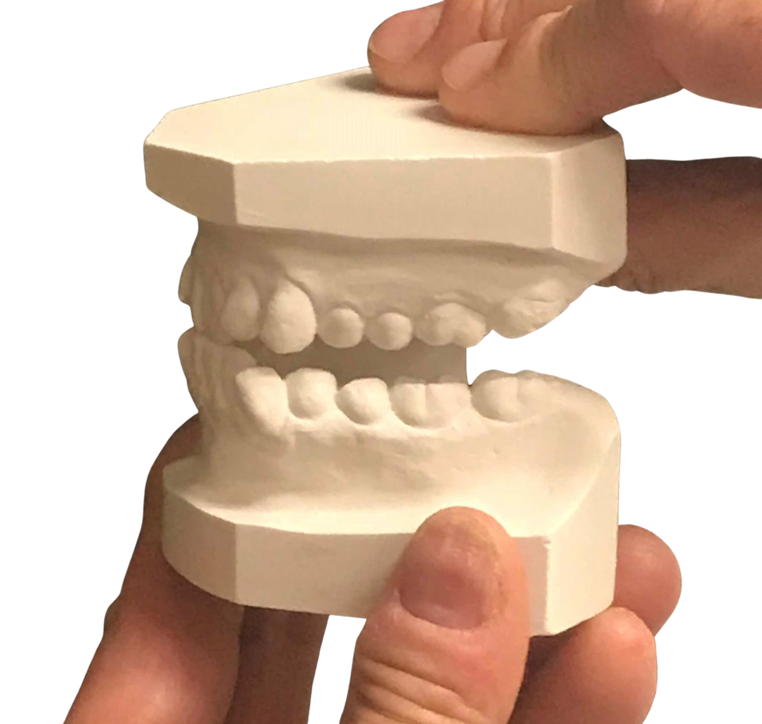
Did You Know?
All cured patients of TMJ disease have a posterior open bite after Phase I.

Slide 34
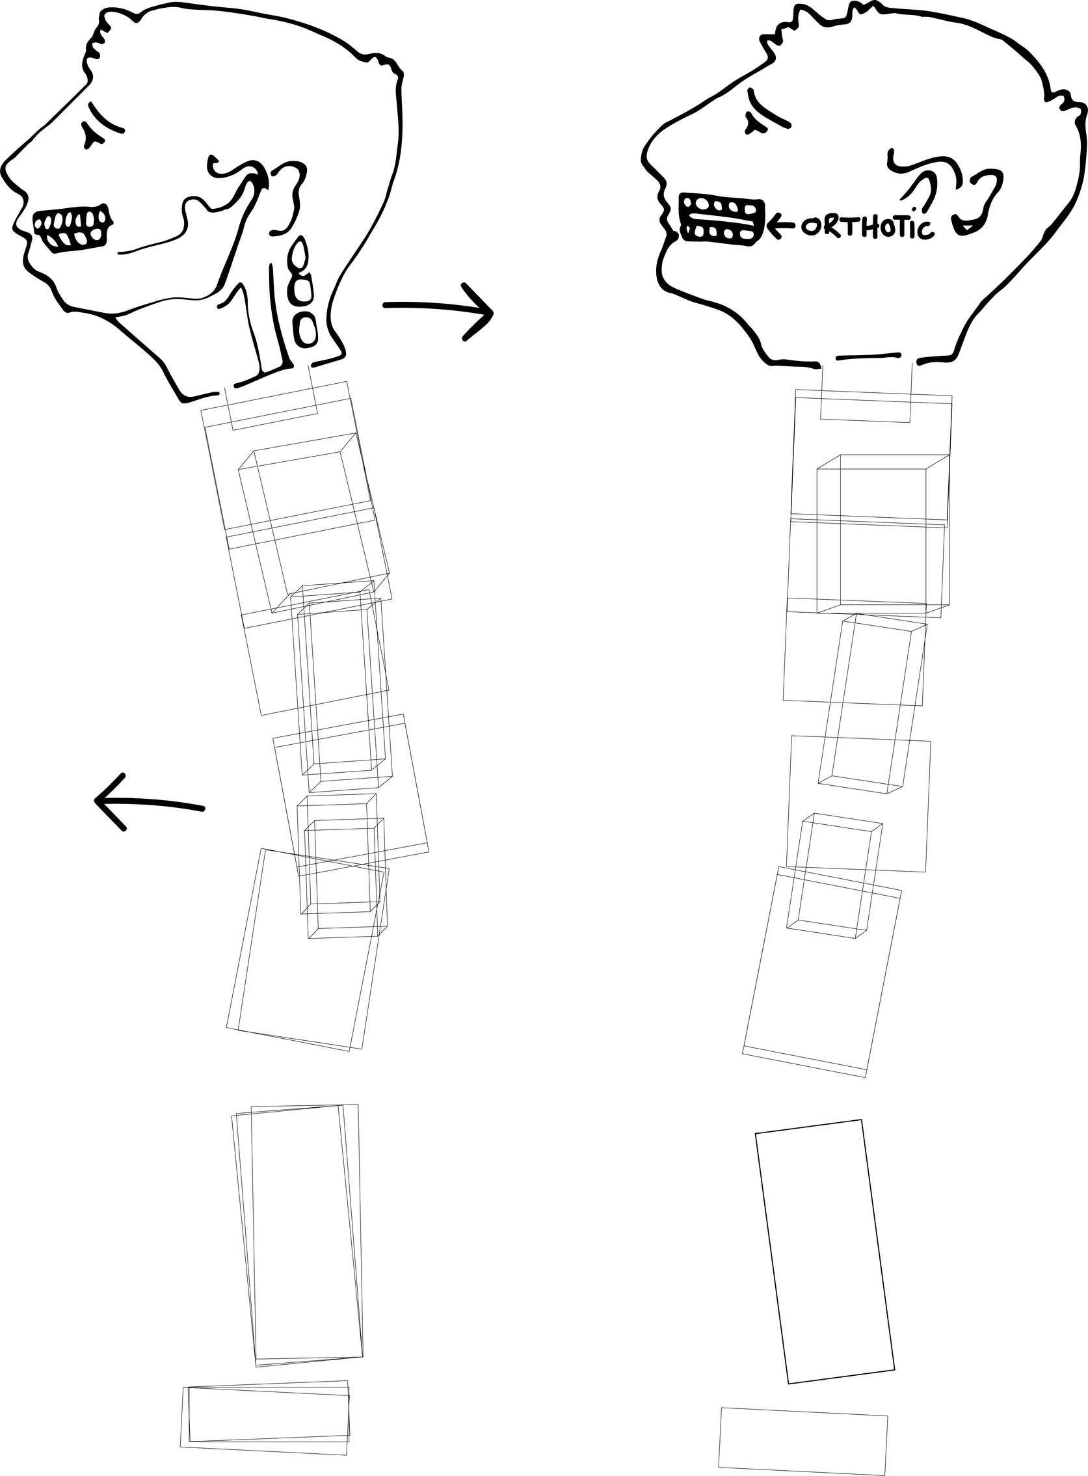
Phase II of TMJ Treatment
Create permanent
functional jaw position
Permanent NMO appliance
Special orthodontic therapy
Never long teeth
Create tooth eruption by building bone (osteoblasts)
Maintain proper intra/extra capsular position
Neuromuscular Orthotic Appliance

Slide 35
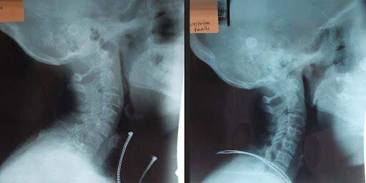
Before & After TMJ
Disease Treatment
40-YEAR-OLD

Slide 36
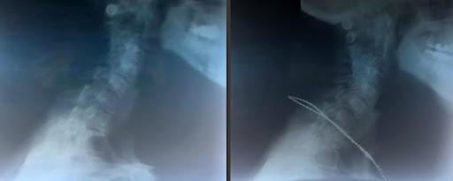
Before & After TMJ
Disease Treatment

Slide 37
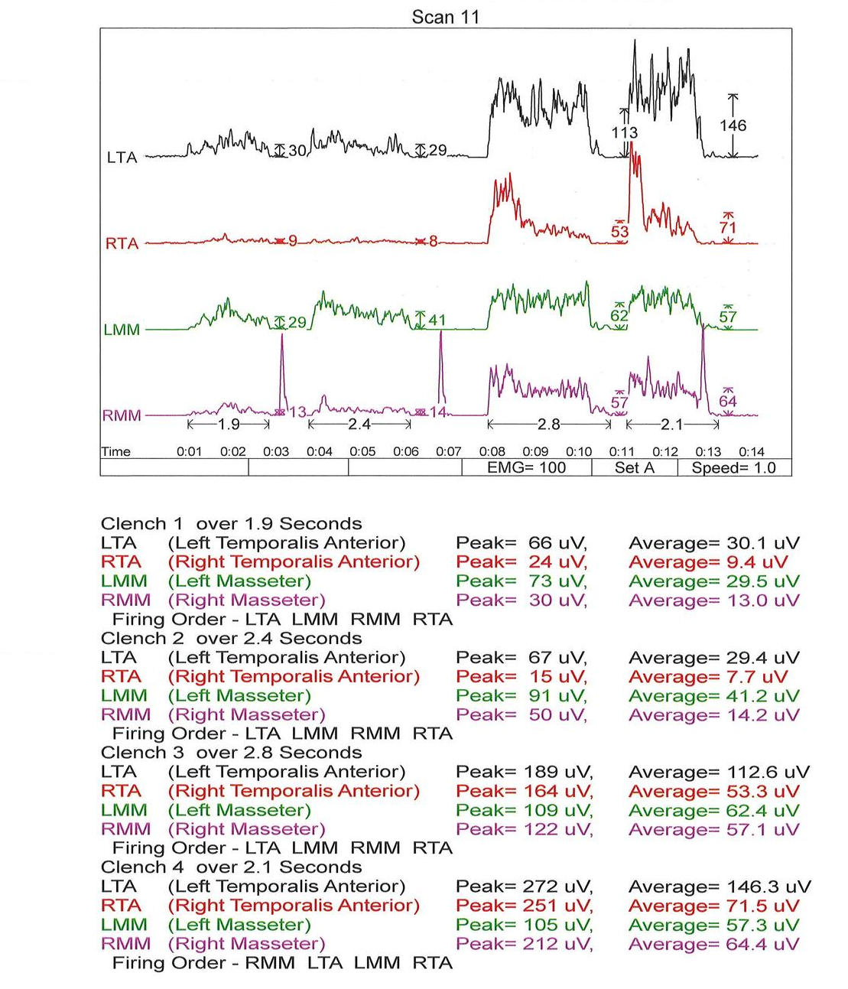
Bite
Recruitment
EMG

Slide 38
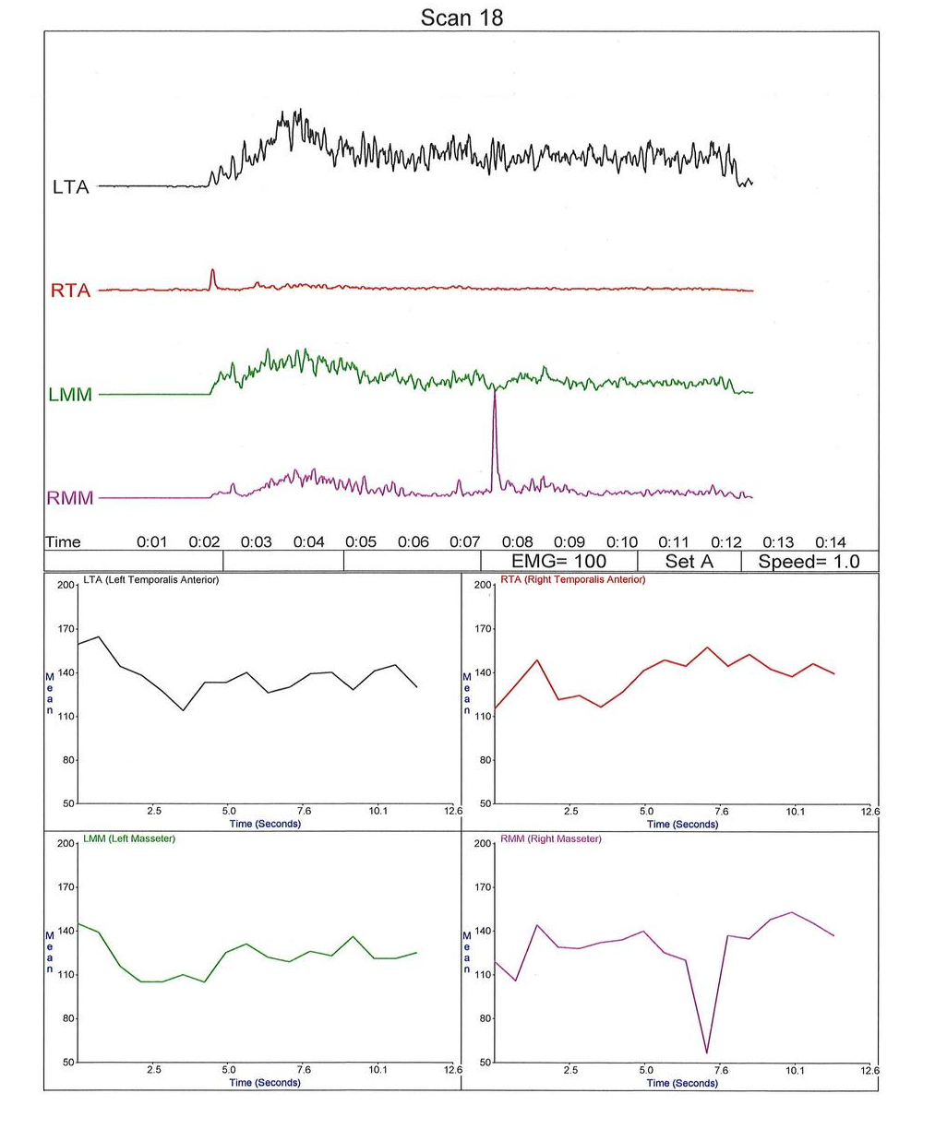
Bite
Recruitment
EMG
10 SECOND INTERVAL

Slide 39
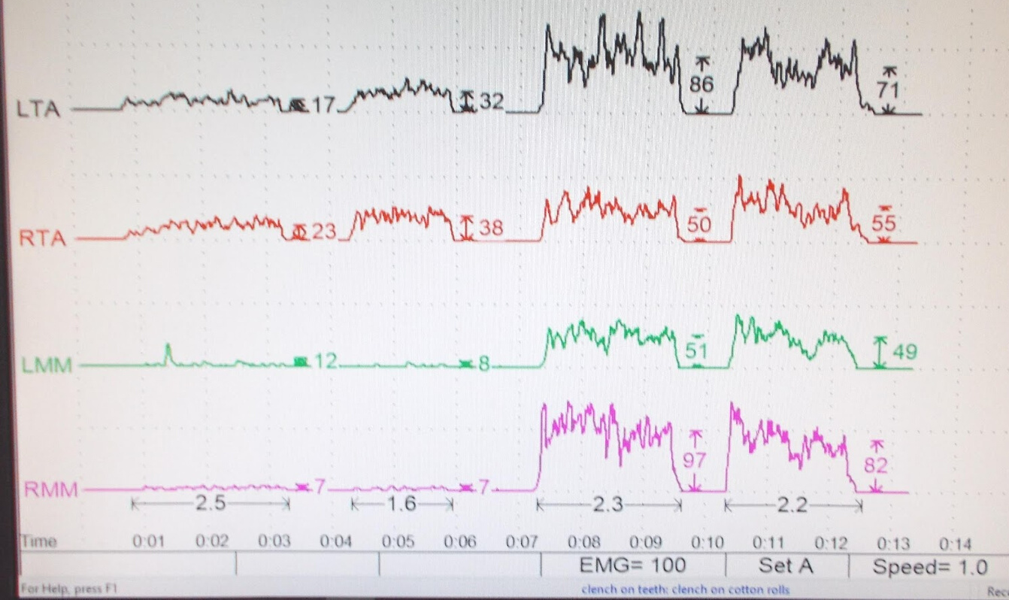
K7 Myotronic Scans
CLENCH ON TEETH
CLENCH ON COTTON ROLLS

Slide 40
TMJ Disease
No Diaphramtic breathing
Panorex can reveal
Forward head posture - body follow head
Posterior teeth intruded (clench)
No recruitment for masseters
Temporalis/masseter imbalance
Form follows dysfunction
High coronoids (attenuated) - temporalis imbalance
Gonial deposition - masseter clench
Not diagnostic for condyles/position in fossae
Results of TMJ Disease:
Intrudes posterior teeth
3-Dimensional Intra-oral imbalance
Condyles move posteriorly, superiorly
Muscles shorten, head comes forward

Slide 41
Treatment is Able To Provide
A neuromuscular bite position with EMG measure to make
a neuromuscular orthotic for optimum 3-dimensional muscle recruitment intra-orally.
INTEGRATE POSTURE WITH BITE
SLEEP APNEA FINDINGS WITH TMJ
Bite change can be seen on orthotic as posture/bite change occur through function.

Slide 42
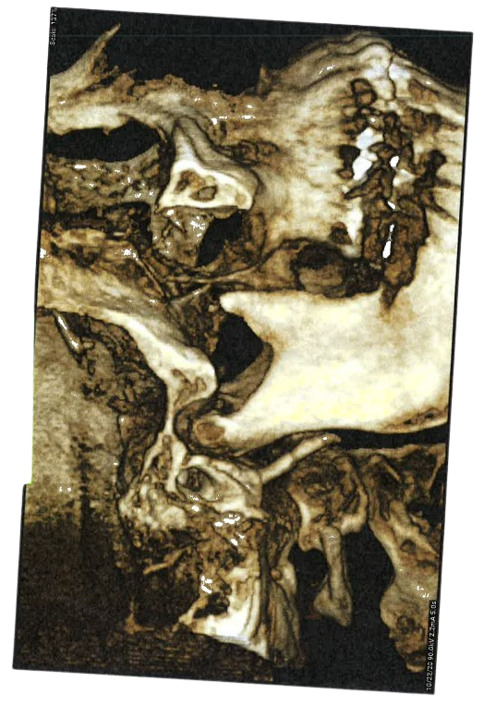
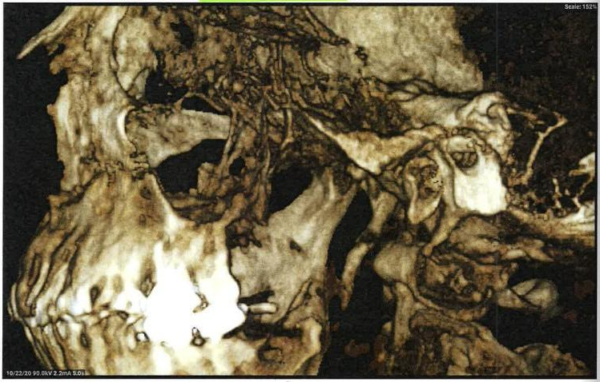
Burning Tongue Case

Slide 43
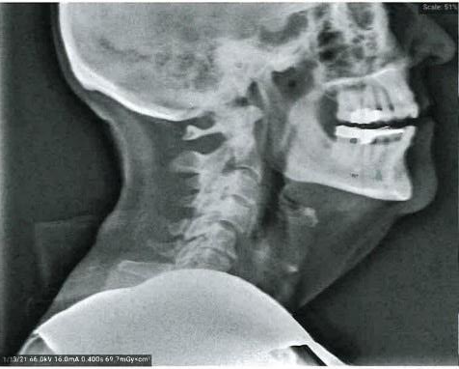
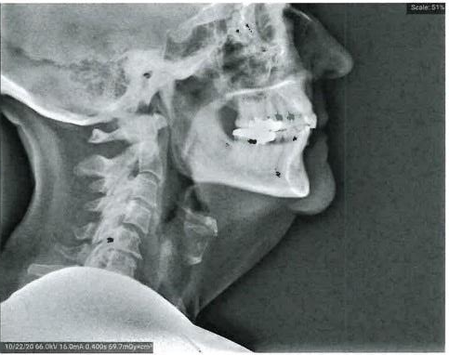
Burning Tongue Case

Slide 44
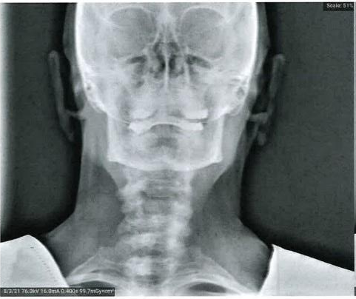
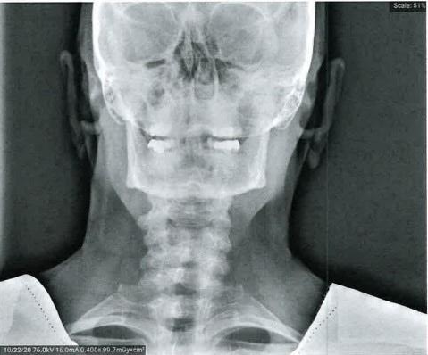
Burning Tongue Case

Slide 45
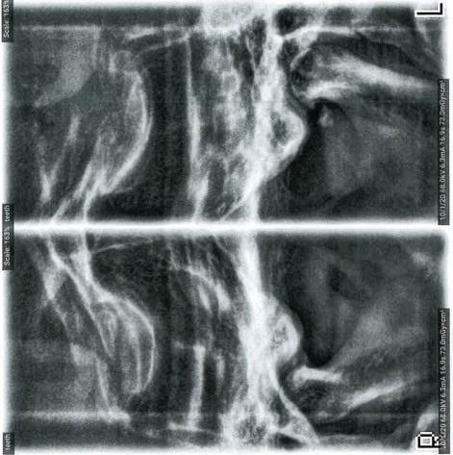
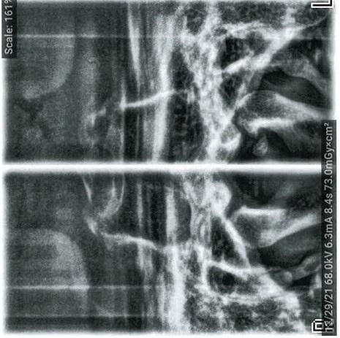
Burning Tongue Case
Natural Teeth
With Orthotic Bite

Slide 46
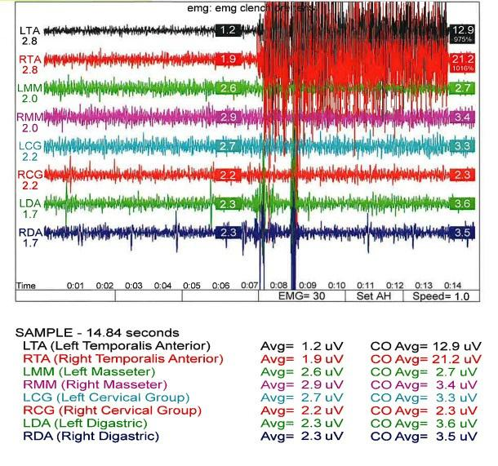
Burning Tongue Case

Slide 47
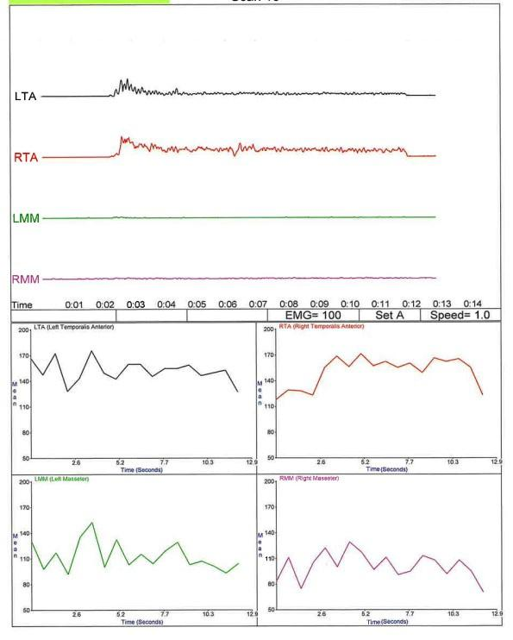
Burning Tongue Case

Slide 48
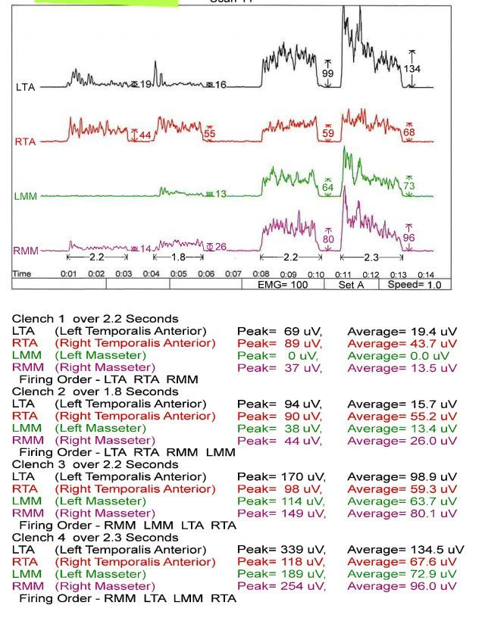
Burning Tongue Case

Slide 49
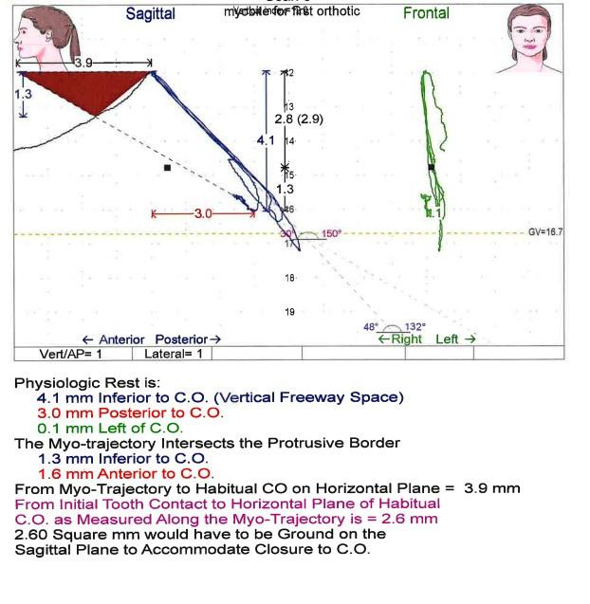
Burning Tongue Case

